Slide 1
Chapter 3
AWT and Swing
(GUI in Java)

Slide 2
AWT Vs Swing
There are two sets of java API for graphics programming
1/awt(Advanced window toolkit)
Sun initial idea.
Not powerful enough.
To import packages containing awt component and container Import java.awt.*;
Example. Frame,Dialog,Panel,Applet,Button…..
2/Swing
Second Edition
Allow much power full computer graphics.
Use prefix “J” to differentiate it from awt components and containers
To import packages containing swing component and container import javax.swing.*;
Example JFrame,JDialog,JPanel,JApplet,JButton…..

Slide 3
AWT vs Swing
AWT is Java’s original set of classes for building GUIs
Uses peer components of the OS; heavyweight components. Each heavyweight component has a peer (from package java.awt.peer) that is responsible for the interactions between the component and the local platform that display and manipulate the component.
Not truly portable: looks different and lays out inconsistently on different Oss
Due to OS’s underlying display management system

Slide 4
Con’t…
Swing is designed to solve AWT’s problems
99% java; lightweight components
Drawing of components is done in java
Uses AWTs components like Window, frame, dialog
Lays out consistently on all OSs
Uses AWT event handling
Swing provides several advanced components such as tabbed pane, scroll panes, trees, tables and lists.
Unlike AWT components, Swing components are not implemented by platform-specific code. Instead they are written entirely in Java and therefore are platform-independent. The term "lightweight" is used to describe such an element

Slide 5
Con’t…
Swing provides replacements for most of the AWT components, although many AWT non-component classes remain in use.
Mixing both Swing and AWT components in the same interface can produce errors, so one has to make a decision about which to use. Despite the advantages of Swing, there actually are arguments for using AWT.
Swing advantages
Swing is faster.
Swing is more complete.
Swing is being actively improved

Slide 6
Con’t…
AWT advantages
AWT is supported on older, as well as newer, browsers so Applets written in AWT will run on more browsers.
The Java Micro-Edition, which is used for phones, TV settup boxes,etc, uses AWT, not Swing

Slide 7
Swing
Swing is Java's GUI(graphical user interface) library
So far, our user interfaces have only been textual, meaning the user sees text and writes text at the command prompt.
Swing is created to provide a more sophisticated set of GUI components than the Abstract Windows Toolkit (AWT)
Today we will learn to make our interfaces graphical, so we can use our programs through windows, click on buttons, etc.
You MUST import the following packages to use swing:
import java.awt.*;
import javax.swing.*;

Slide 8
Con’t…
Swing is a Java package, javax.swing, provided in J2SDK (Java 2 Software Development Kit). It provides many enhancements to the existing graphics package, AWT (Abstract Windows Toolkit) package, java.awt.
javax.swing and java.awt together offer a complete API (Application Programming Interface) for Java applications to operate graphical devices and create GUI (Graphical User Interfaces).
The Swing components are implemented entirely in the Java programming language.

Slide 9
What are Components?
A component is an object having a graphical representation that can be displayed on the screen. like checkboxes, menus, windows, buttons, text fields, applets, and more.
A container is a special component that can hold other components.
Example of containers in typical GUI applications include:
panels, windows, applets, frames
Functionality of most GUI components derive from the Component and Container classes.

Slide 10
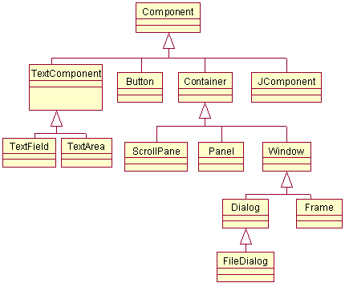
Components Hierarchy

Slide 11
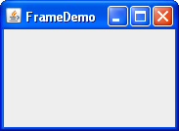
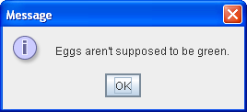
Swing Containment Hierarchy
Top-level container:
place for other Swing components to paint themselves
e.g., JFrame, JDialog

Slide 12
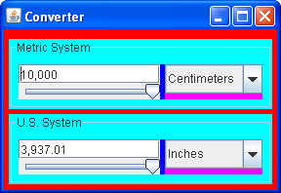
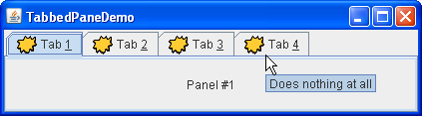
Swing Containment Hierarchy
Intermediate container:
simplify positioning of atomic components
e.g., JPanel, JSplitPane, JTabbedPane

Slide 13

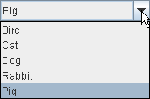
Swing Containment Hierarchy
Atomic components:
self-sufficient components that present information to and get input from the user
e.g., JButton, JLabel, JComboBox, JTextField, JTable

Slide 14
Implementing a Swing GUI
Import javax.swing.*, java.awt.*
Make a specific class to do GUI functions
Specify all the GUI functions/components in the class’s constructor (or methods / classes called by the constructor)
Run the GUI by instantiating the class in the class’s main method

Slide 15

My First Swing Program
import javax.swing.*;
public class HelloWorldSwing {
public static void main(String[] args) {
// let’s create a frame object and give some title
JFrame frame = new JFrame("HelloWorldSwing");
// let’s have a label
JLabel label = new JLabel("Hello World");
//let’s add the label to the frame we have created above
frame.getContentPane().add(label);
//this is the operation to do when the window is closed.
frame.setDefaultCloseOperation(JFrame.EXIT_ON_CLOSE);
//pack() causes a window to be sized to fit the preferred
//size and layouts of its sub-components
frame.pack(); // let’s make the frame to be visible
frame.setVisible(true);
}
}
15

Slide 16
Example 2
import javax.swing.*;
public class HelloWorldFrame extends JFrame {
public HelloWorldFrame() {
super(“HelloWorldSwing”);
final JLabel label = new JLabel("Hello World");
getContentPane().add(label);
setDefaultCloseOperation(JFrame.EXIT_ON_CLOSE);
pack();
setVisible(true);
}
public static void main(String[] args) {
HelloWorldFrame frame = new HelloWorldFrame();
}
}
In this example a custom frame is created

Slide 17
Components
Components (also known as "widgets") are the basic user interface elements the user interacts with: labels, buttons, text fields, ...
Components are placed in a container (eg, JPanel). The visual arrangement of the components depends on the container's layout. When the user does something to a component, the component's listener is sent an event.

Slide 18
Components cont'd...
The most important components to learn for simple programs are:
Input Components
Buttons ( JButton, Radio Buttons, JCheckBox)
Text (JTextField, JTextArea)
Menus (JMenuBar, JMenu, JMenuItem)
Sliders (JSlider)
JComboBox (uneditable) (JComboBox)
Information Display Components
JLabel
Progress bars (JProgressBar)
Tool tips (using JComponent's setToolTipText(s) method)

Slide 19
Components cont'd...
Choosers
File chooser (JFileChooser)
Color chooser (JColorChooser)
More complex displays
Tables (JTable)
Trees (JTree)

Slide 20
Components cont'd...
Components and Their Description
Jlabel: An area where uneditable text or icons can be displayed.
JTextField :An area in which the user inputs data from the keyboard. The area can also display information.
Jbutton: An area that triggers an event when clicked.
JcheckBox: A GUI component that is either selected or not selected.
JcomboBox: A drop-down list of items from which the user can make a selection by clicking an item in the list or possibly by typing into the box.
Jlist: An area where a list of items is displayed from which the user can make a selection by clicking once on any element in the list. Double-clicking an element in the list generates an action event. Multiple elements can be selected.
Jpanel: A container in which components can be placed.

Slide 21
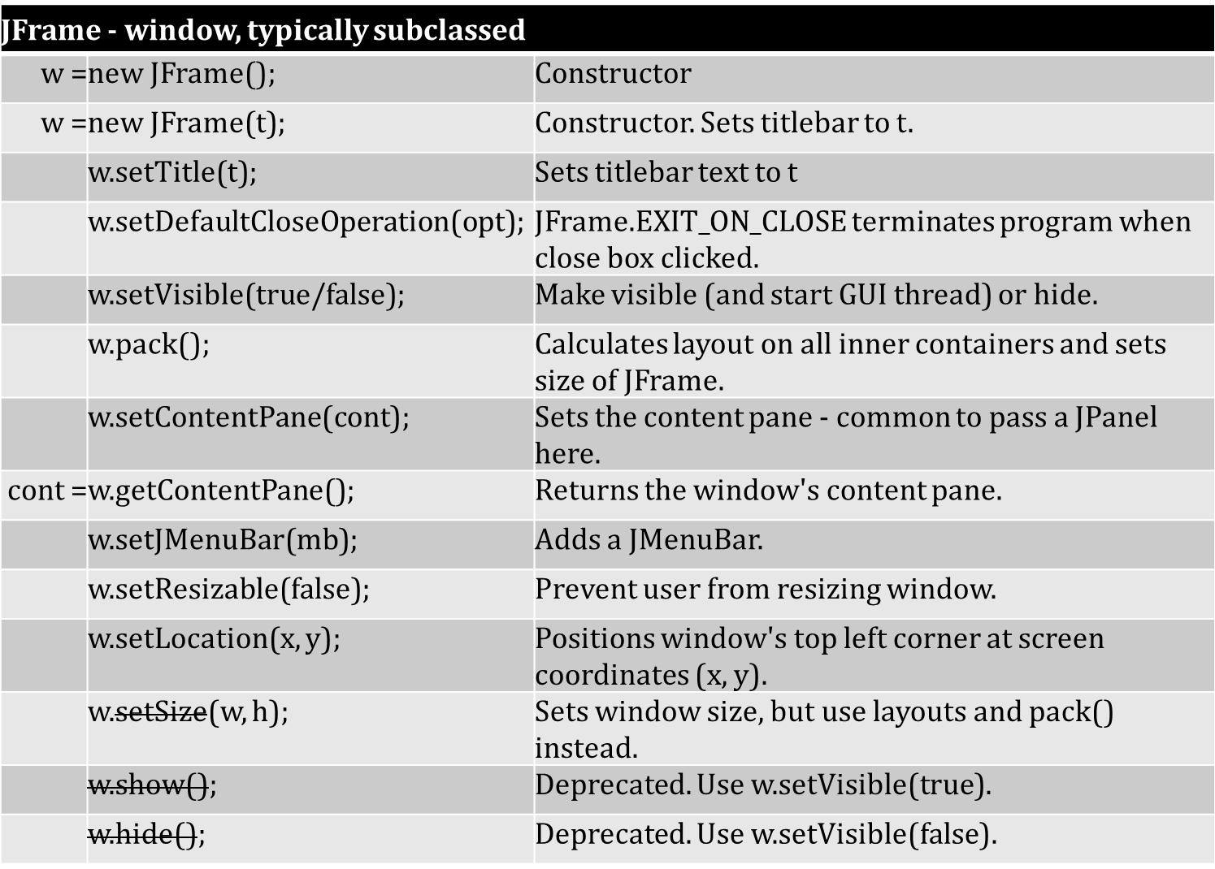
Top-level Container: javax.swing.JFrame

Slide 22
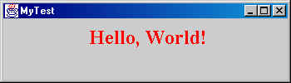
Anatomy of a JFrame
title bar
minimize
maximize
close
The contentPane holds your content; created automatically when a JFrame is created

Slide 23
JFrame
JFrame is the application window class
It draws the window and interacts with the operating system
When a JFrame is created, an inner container called the contentPane is automatically created
We don't draw graphics directly on JFrame; we draw on the contentPane
Frames are the basis of any Java GUI
Frame is the actual window that encompasses your GUI objects; a GUI can have multiple frames
The “J” prefix is at the beginning of any Swing component’s name (to distinguish them from AWT components)

Slide 24
JFrame
The javax.swing.JFrame class is used to create a "window". This window has a few characteristics of its own (title bar, etc), but most of the controls are placed in one of two subareas: content pane or menu bar.
You can create a frame like this:
JFrame w = new JFrame("your title");
// but it's better to use subclassing as below.
Subclass JFrame, build in constructor. Another better way is to define a class, eg on page 16 class HelloWorldFrame that extends JFrame, put the code which builds the GUI in the class's constructor, and create an instance of the window from the main program.

Slide 25
Jframe(cont)
Content pane - Two styles - Get it or Set it
There are two common ways to use a JFrame's content pane. Both are commonly used. In both cases, the easiest style is to assign the working version of the content pane.
Get the predefined content pane and change it. Every JFrame comes with a default content pane. It doesn't have anything on it, although it does have a default layout, probably not the one you want to use though! The getContentPane() method returns a Container object, which interestingly is actually a Jpanel.
Create a JPanel and make it the content pane. This requires a call to setContentPane(...).

Slide 26
Jframe(cont)
Using the content pane.
c = | w.getContentPane(); |  | Returns window's content pane.
 | w.setContentPane(c); |  | Sets window's content pane to c (or subclass JPanel).
Handling the window's close box.
w.setDefaultCloseOperation(JFrame.EXIT_ON_CLOSE); |  |  |  | This adds a window listener that simply executes System.exit(). It's the short, appropriate, solution for most small programs.
w.addWindowListener(listen); |  |  |  | Use this to call your own window closing listener.
Executing the layout.
w.pack(); |  | Finalize layout after everything is added to window and content pane. Don't use validate() with layout managers.

Slide 27
Jframe(cont)
Displaying the window.
w.setVisible(true); |  | Makes the window visible, and starts the Event Dispatch Thread (EDT) which manages the GUI. This is usually called by the main program after calling the constructor. show() should no longer be used.
Miscellaneous.
w.setTitle(title); |  |  | xxx
w.setResizable(false); |  |  | Set to false if you don't want the user to resize your window.
w.setJMenuBar(mbar); |  |  | This is how to add a menubar to the window.
w.setLocationRelativeTo(null); |  |  | Centers the window. If you even bother with position, this is the most common choice.
Less common positioning and sizing.
w.setSize(w, h); | Sets window to pixel width (w) and height (h). The only reasons to use this are to fill the screen or restore a window size from a previous run.
w.setLocation(x, y); | Sets the upper left corner of the window to this screen pixel coordinate.

Slide 28
Jframe(cont) Window Size and Position
First pack your window to do the layout : The optimum size of a window depends on the size and layout of the components. After adding all the components to a window (JFrame), call pack() to perform the layout.
Centering a Window : The following code positions a window (JFrame) f in the center of the screen. Use this when you create a window, after calling pack() has been called, as follows.
setLocationRelativeTo(null);
// Implicit "this" if inside JFrame constructor.
f.setLocationRelativeTo(null);
// Explicit JFrame if outside JFrame constructor.

Slide 29
Jframe(cont) Content Panes
Before Java 2 each top-level container had only one layer. Java 2 top-level containers (JFrame, JApplet, ...) have several layers (panes): root, content, layered, and glass. Programs normally reference only the content pane. There are two programming idioms for using the content pane:
(1) using the preassigned pane (recommended), or (2) building your own pane.
Naming convention
It is common to name the content pane content or content Pane.

Slide 30
Jframe(cont) Content Panes
Idiom 1: Use the existing content pane
Each container has a pre constructed content pane of class Container. You can get this pane and add the components to it. For example,
class MyWindow extends JFrame {
. . .
MyWindow() {
// constructor
Container content = getContentPane();
// Use the default content pane.
content.add(...);
content.add(...);
. . .
}
…

Slide 31
Jframe(cont) Content Panes
All JFrames already have a content pane, so there's no need to create a new one, just get the existing pane. And if you're wondering about the Container type, it's a superclass of JPanel. In fact, if you look at the actual type of the object that's currently returned by getContentPane(), it really is a Jpanel.
Sometimes programmers don't bother to copy the content pane reference into a new variable, resulting in code like this. Since there are typically a large number of references to the content pane, this seems awkward.
class MyWindow extends JFrame {
MyWindow() {
// constructor
getContentPane().add(...);
getContentPane().add(...);
. . .

Slide 32
Jframe(cont) Content Panes
Idiom 2: Create your own content pane
It's common to create a new panel for the content pane and tell the window to use this new panel for it's content pane. For example,
class MyWindow extends JFrame {
MyWindow() {
// constructor
JPanel content = new JPanel();
// Create a new content pane.
content.add(...);
content.add(...);
. . .
setContentPane(content);
}
}

Slide 33
Where to declare components
Components are typically declared in one of several places:
Field variables : Some components should be declared as field variables (instance variables, member variables). This is the appropriate place to declare components which must be referenced after the interface is constructed. Typically these are text fields or text areas, check boxes, etc. Those components whose values must be gotten or set.
Local variables : Local variables should be used for components which are never referenced after the interface is constructed. Typically these are panels for holding components, buttons (whose interaction is through their listeners), ... Local variables disappear when the method they are in returns, but the component will continue to exist if it has been added to the interface.
Anonymous : Anonymous creation is typical with labels, which can be created and added in one step and never assigned to a variable. Of course, if the appearance (font, alignment, ...) must be changed, then they should be put in a local variable. Some programs use labels for output (not a good idea), and in this case they should be field variables. Example content.add(new JLabel("Look at this"));

Slide 34
JLabel
Labels display fixed text or images on a GUI as information to the user, for example, as a label in front of a JTextField, etc. You can have text (including HTML), an image, or both on a JLabel. A JLabel has a transparent background, so it will always match the container it is in.
JLabel Constructors
Assume the following declarations.
String text;
Icon image;
int alignment; // JLabel.LEFT, JLabel.Center, or JLabel.RIGHT.
JLabel yourLabel = new JLabel(text);
JLabel yourLabel = new JLabel(text, alignment);
JLabel yourLabel = new JLabel(image);
JLabel yourLabel = new JLabel(image, alignment);
JLabel yourLabel = new JLabel(text, image, alignment);

Slide 35
Jlabel(cont)
Java Idiom
Because there is usually no need to refer to a JLabel after it has been added to a container, it is common to combine creation and adding the JLabel in one statement.
For example.
...
p.add(new JLabel("Enter your ID:", JLabel.RIGHT));
is the same as
JLabel idLabel = new JLabel("Enter ID:", JLabel.RIGHT);
. . .
p.add(idLabel);

Slide 36
Jlabel(cont)
JLabel font and color
The most user-friendly interfaces are usually obtained by using the default appearance (font, color, background), but there are cases where you want to change these.
Appearance: setting the font
The font of a JLabel can be changed like this.
JLabel title = new JLabel(“Enter Name :", JLabel.CENTER);
title.setFont(new Font("Serif", Font.BOLD, 48));

Slide 37
Jlabel(cont)
Appearance: setting the text color
Use the setForeground method to set the text color.
JLabel title = new JLabel(“Name :", JLabel.CENTER); title.setForeground(Color.white);
Appearance: setting the background color
Because a JLabel's background is transparent, there is no effect from using the setBackground method. To make a new background, you need to create a JPanel with the appropriate color and put the label on that. For example
JLabel title = new JLabel(“Enter your name"); title.setForeground(Color.white);
JPanel titlePanel = new JPanel(); titlePanel.setBackground(Color.blue);
titlePanel.add(title);

Slide 38
Jlabel(cont)JLabel for output
Why using JLabel for output is usually bad
It's possible to change the text of a JLabel, although this is not generally a good idea after the user interface is already displayed. For output JTextField is often a better choice. The use of JLabel for output is mentioned because some textbooks display output this way. Here are some reasons not to use it.
Can't copy to clipboard. The user can not copy text from a JLabel, but can from a JTextField.
Can't set background. Changing the background of individual components probably isn't a good idea, so this restriction on JLabels is not serious. You can change the background of a JTextField, for better or worse.
Text length. This is where there are some serious issues. You can always see the entire text in a JTextField, although you might have to scroll it it's long. There are several possibilities with a JLabel. You may either not see all of the long text in a JLabel, or putting long text into a JLabel may cause the layout to be recomputed, resulting in a truly weird user experience.

Slide 39
Jlabel(cont)
Changing the text of a JLabel
Most JLabels are never changed, except for internationalization, and that is done before the user interface is shown. To change the text, use
yourLabel.setText(String newText);

Slide 40
JTextField
javax.swing.JTextField has two uses.
Input. The user can enter one line of text (a String)
Output. To display one line of text.
If you need a component that displays or allows entry of more than one line, use a JTextArea.
Overview of methods
JTextField
 | JTextField(width)
 | setText(text)
String | getText()
 | addActionListener(listener)
 | setEditable(true/false)
 | setFont(font)
 | setHorizontalAlignment(align)
 | requestFocus(align)

Slide 41
JTextField(cont)
To use a JTextField for Input
Declare a JTextField as an instance variable. Reason: If it's an instance variable, it can be seen in all methods in the class.
Assign an initial value to this variable by calling the JTextField constructor. Specify the approximate field width in the constructor. Example:
JTextField yourInpuField = new JTextField(16);
Add the text field to a container.
content.add(yourInputField);
or to add it to a JPanel p
p.add(yourInputField);
4. Input is done by calling the getText().
Get the string in the text field by calling yourTextField.getText() method whenever you need it. This is probably the most common way.
String x = yourInputField.getText();
Attach an action listener to the text field. It is called whenever the user types Enter in that field. The listener can then get the text and process it.

Slide 42
JTextField(cont)
To use a JTextField for Output
Using a JTextField for output is almost the same as for input, but .
Set the text field with yourTextField.setText(someString)
If it's only for output, call .setEditable(false) so the user can't change the field. Here is the sequence.
Declare and initialize a JTextField as a field variable (instance variable). Example:
1. JTextField myOutput = new JTextField(16);
You can also set the initial value in the field
JTextField myOutput = new JTextField("someInitialValue", 20);
2. Add the text field to a container. For example, to add it to JPanel p. p.add(myOutput);
3. Setting the value of the text field. Whenever you want put a string value in the text field, call myOutput.setText("Some text"). myOutput.setText("some text");

Slide 43
JTextField(cont)
Constructors
JTextField tf = new JTextField(int columns);
The number of columns is approximate because the width of text depends on the font and width of individual characters.
JTextField tf = new JTextField(String initial);
This puts the initial String in the JTextField. The size of the JTextField is set from this String.
JTextField tf = new JTextField(String initial, int columns);
This creates a JTextField columns wide with value initial.

Slide 44
JTextField(cont)
Common methods
Here are some of the most common methods use with text fields: Assume these declarations
JTextField tf;
ActionListener listener;
String s,
text;
Font f; //--- When used for input.
s = tf.getText(); // gets the text from the JTextField tf.addActionListener(listener);// Optional listener intialization.
//--- When used for output.
tf.setText(text); // Sets text in the JTextField.
tf.setEditable(false); // Initialization to disallow user changes.
//--- To change the appearance.
tf.setHorizontalAlignment(align);//See below for possible values.
tf.setFont(f); // sets the font for the text

Slide 45
JTextField(cont)
Appearance of a JTextField - font, alignment
yourField.setFont(Font f); sets the font for the text. Often numbers are aligned to the right (eg, in the display of a calculator), and text is aligned to the left.
yourField.setHorizontalAlignment(align); sets the alignment of the text in the field, where align is one of these values: JTextField.LEFT (the default), JTextField.CENTER, or JTextField.RIGHT.
Example
JTextField userID; // declare a field . . .
userID = new JTextField(8); // create field approx 8 columns wide. p.add(userID); // add it to a JPanel
userID.addActionListener(
new ActionListener() {
public void actionPerformed(ActionEvent e) {
... // THIS CODE IS EXECUTED WHEN RETURN IS TYPED
}
}
);

Slide 46
JTextField(cont)
Use JPasswordField for passwords
Use a JPasswordField component for a field where the characters the person enters are replaced by some other character. JPasswordField is a subclass of JTextField.
Use JFormattedTextField to restrict input format
The JPasswordField subclass of JTextField can be used to restrict the input to particular values.
Focus
To select a JTextField so that user typing occurs in that field, you must give the JTextField focus. For example, the nameField JTextField can be given focus with:
nameField.requestFocus();

Slide 47
JTextArea
A javax.swing.JTextArea is a multi-line text component to display text or allow the user to enter text.
Using a JTextArea for output -- Setting the text
Assume: JTextArea ta;
int i, w, pos, start, end, line;
String s; boolean b;
Font f;
Result |  | Method |  | Description
Constructors
ta = | new JTextArea(rows, cols); |  | Creates text area. cols is approx char width.
ta = | new JTextArea(s, rows, cols); |  | As above, but also containing initial string s.

Slide 48
JTextArea(cont)
Result Method Description
Setting text
 | ta.setText(s); | Replaces all text with s.
 | ta.append(s); | Appends s to the end.
 | ta.insert(s, pos); | Inserts s at position pos.
 | ta.replaceRange(s, start, end); | Replace start to end with s.
Getting text
s = | ta.getText(); | Returns all text. Use methods below to get individual lines.
i = | ta.getLineCount(); | Returns number of lines in the text area.
i = | ta.getLineStartOffset(line); | Returns character index of beginning of line line. May throw javax.swing.text.BadLocationException.
i = | ta.getLineEndOffset(line); | Returns character index of end of line line. May throw javax.swing.text.BadLocationException.

Slide 49
JTextArea(cont)
Scrolling
JTextArea doesn't support scrolling itself but you can easily add the JTextArea to a JScrollPane. JScrollPane creates scrollbars as needed. For example,
//... Create scrolling text area.
resultTA = new JTextArea("This is a test", 10, 80); JScrollPane scrollingResult = new JScrollPane(resultTA);
content.add(scrollingResult);

Slide 50
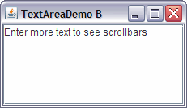
JTextArea(cont)
public class TextAreaDemoB extends JFrame {
JTextArea _resultArea = new JTextArea(6, 20);
public TextAreaDemoB() {
//... Set textarea's initial text, scrolling, and border. _resultArea.setText("Enter more text to see scrollbars");
JScrollPane scrollingArea = new JScrollPane(_resultArea);
//... Get the content pane, set layout, add to center
JPanel content = new JPanel();
content.setLayout(new BorderLayout());
content.add(scrollingArea, BorderLayout.CENTER);
//... Set window characteristics.
this.setContentPane(content);
this.setTitle("TextAreaDemo B"); this.setDefaultCloseOperation(JFrame.EXIT_ON_CLOSE);
this.pack(); }
public main public static void main(String[] args) {
JFrame win = new TextAreaDemoB();
win.setVisible(true);
}
}

Slide 51
Java: Buttons
There are many kinds of buttons, all derived from the AbstractButton class.
Components | Description
JButton | This is a standard button which can have text, icon, or both. Listener: addActionListener(...)
JCheckBox | The box next to the text can be toggled on or off.
JRadioButton, ButtonGroup | Radio buttons are a group of buttons that can have at most one button toggled on. When you click one button, that button is toggled on, and all others are set to off.
JMenuItem | Menu items are a kind of button.
JToggleButton | Changes between two states: on and off. Stays on/off until the next click.

Slide 52
JButton
There are a few steps in using a button: declaring it, creating it, adding it to a container (the content pane or a JPanel), and adding a listener that has code to execute when the user clicks on the button. Images can be used on buttons, including automatic rollover effects.
Constructors
Assume these declarations.
String text;
Icon image;
JButton btn = new JButton(text); JButton btn = new JButton(text, image); JButton btn = new JButton(image); Common methods
Assume these declarations:
JButton btn;
ActionListener listener;
boolean b;
//--- Buttons always have action listeners. btn.addActionListener(listener);
btn.setEnabled(b);

Slide 53
Jbutton(cont)
Events : When a button is clicked, the actionPerformed() method is called for all of the button's listeners. It is passed an ActionEvent, which is generally ignored, but can be used to identify which component generated the event if several share the same listener. The example below shows the creation of a button, attaching a listener, and adding the button to a container.
Example
Typically a button is assigned to a local variable (not an instance variable) and an anonymous action listener is added to it. The listener often calls another method to do everything because separating the code to build the user interface and do the "semantics" makes a program clearer and easier to modify.
JButton mybtn = new JButton("Do Something"); mybtn.addActionListener( new ActionListener() {
public void actionPerformed(ActionEvent e) {
doMyAction(); // code to execute when button is pressed
}
}
); . . .
content.add(mybtn); // add the button to a JPanel (eg, content).

Slide 54
Jbutton(cont) JButton Appearance
Dynamically changing a button
You can change the text or icon (image) that appears on a button with:
btn.setText("someText");
btn.setIcon(anIcon);
WARNING: If you change the size of the button by one of these changes, this may have consequences in the layout of the components. This may require a call to validate() or revalidate() which then computes a new layout based on the change in the button size. This is not a quick operation. Replacing an icon with another of the same size should not cause any problems.

Slide 55
Jbutton(cont) Buttons with Icons
You can create buttons that show text, icons (images), or both. Different images can be associated with different button states and user interactions with the button (disabled, rollover, ...). The two supported image formats are GIF and JPEG, although support for more image types is being worked on.
To create a button with an icon
JButton next = new JButton(new ImageIcon("right.gif"));
or
JButton next = new JButton("Next", rightArrow);

Slide 56
JComboBox (uneditable)
Making Choices
There are several ways to select one of many fixed choices: radio buttons, a menu, a list, or a (uneditable) combo box. A combo box (JComboBox) is a popup menu and is often the best component to use because it uses less space than radio buttons or a list, and it shows as part of a "form" so the user realizes it's there, unlike a menu. You can also use an editable combo box, and in this case the user can either choose from the pop-up menu or type in a value.
Constructor
An easy way to build a combo box is to initialize an array (or Vector, but not yet the new Collections types) of strings and pass it to the constructor. Objects other than strings can be used, but this is the most common. The list also be built by successive calls to the add method.
String[] dias = {"lunes", "martes", "miercoles"};
JComboBox dayChoice = new JComboBox(dias);

Slide 57
JComboBox (uneditable)
Events
A JComboBox generates both ActionEvents (like buttons, text fields, etc), or ItemEvents. Because it is easier to work with ActionEvents, we'll ignore the ItemEvents. When the user chooses an item from a combo box, an ActionEvent is generated, and the listener's actionPerformed method is called. Use either getSelectedIndex to get the integer index of the item that was selected, or getSelectedItem to get the value (eg, a String) that was selected.
Example
This example creates a JComboBox, and adds a listener to it. The getSelectedItem method returns an Object type, so it's necessary to downcast it back to a String.
String[] fnt = {"Serif", "SansSerif", "Monospaced"};
JComboBox fontChoice = new JComboBox(fnt); fontChoice.addActionListener( new ActionListener() {
public void actionPerformed(ActionEvent e) {
JComboBox combo = (JComboBox)e.getSource();
currentFont = (String)combo.getSelectedItem();
}
});

Slide 58
JCheckBox
A javax.swing.JCheckBox shows a small box that is either marked or unmarked. When you click on it, it changes from checked to unchecked or vice versa automatically. You don't have to do any programming for the checkbox to change.
There are two ways to use a checkbox:
Active. Use addActionListener or addItemListener() so that a method will be called whenever the checkbox is changed.
Passive. Use isSelected() to test if a checkbox is checked.

Slide 59
JCheckBox(cont)
Common constructors and methods
Assume JCheckBox cb; // A checkbox.
String text; // Label on text box.
boolean state; // True/false state of checkbox.
Constructors
cb = | new JCheckBox(text); | Creates check box, initially unchecked.
cb = | new JCheckBox(text, state); | Creates check box, checked or not depending on state.
Methods
state = | cb.isSelected(); |  | Returns true if the check box is checked.
 | cb.setSelected(state); |  | Checks (true) or unchecks check box.
 | cb.addActionListener(action-listener); |  | Adds an action listener to the radio button. The action listener will be called if button is selected.
 | cb.addItemListener(item-listener); |  | Add an item listener to a radio button. The item listener will be called if the button is selected or deselected.

Slide 60
JCheckBox
Example using an ActionListener
An ActionListener should probably be preferred to an ItemListener, and this needs to have a little more explanation.
Example with anonymous inner class ItemListener
This example creates a checkbox (ignoreCase) that is already checked, and adds it to the JPanel (content). It sets the boolean variable (ignore) whenever the box state is changed by the user.
boolean ignore = true; // true if should ignore case . . .
JCheckBox ignoreCase = new JCheckBox("Ignore Case", true); ignoreCase.addItemListener(
new ItemListener() {
public void itemStateChanged(ItemEvent e) {
// Set "ignore" whenever box is checked or unchecked. ignore = (e.getStateChange() == ItemEvent.SELECTED);
}
}
);
content.add(ignoreCase);

Slide 61
JCheckBox
Example checking state
This example is similar to the above, but gets the state of the checkbox when the value is needed.
JCheckBox ignoreCase;
. . . //... inside window constructor
JCheckBox ignoreCase = new JCheckBox("Ignore Case", true); content.add(ignoreCase);
. . .
//... Inside processing method, eg in button listener.
if (ignoreCase.isSelected()) {
. . .

Slide 62

Radio Buttons(cont)
Radio buttons (javax.swing.JRadioButton) are used in groups (java.awt.ButtonGroup) where at most one can be selected. The example below produced this image. A radio button group starts with all buttons deselected, but after one is selected the only way to have them appear all off is to have an invisible button that is selected by the program.

Slide 63
Radio Buttons(cont)
Source code for above example
This example creates a group of three radio buttons, puts them in a grid layout on a panel, and puts a titled, etched border around them.
JRadioButton yesButton = new JRadioButton("Yes" , true); JRadioButton noButton = new JRadioButton("No" , false); JRadioButton maybeButton = new JRadioButton("Maybe", false);
ButtonGroup bgroup = new ButtonGroup(); bgroup.add(yesButton);
bgroup.add(noButton);
bgroup.add(maybeButton);
JPanel radioPanel = new JPanel(); radioPanel.setLayout(new GridLayout(3, 1));
radioPanel.add(yesButton);
radioPanel.add(noButton);
radioPanel.add(maybeButton); radioPanel.setBorder(BorderFactory.createTitledBorder( BorderFactory.createEtchedBorder(), "Married?"));

Slide 64
Radio Buttons(cont)
Testing the status of radio buttons
There are several ways to find out about radio button states:
During execution, test the radio button with isSelected().
In the setup phase, add an action listener with addActionListener(...). ActionListeners are called when a radio button is selected.
In the setup phase, add an item listener with addItemListener. ItemListeners are called both when the radio button is selected and (automatically) deselected.

Slide 65
Radio Buttons(cont)
JRadioButton methods
boolean b;
JRadioButton rb = new JRadioButton("Sample", false);
Common JRadioButton methods
b = | rb.isSelected(); | Returns true if that button is selected.
 | rb.setSelected(b); | Sets selected status of a radio button to b (true/false).
 | rb.addActionListener(an-action-listener); | Adds an action listener to the radio button. The action listener will be called if button is selected.
 | rb.addItemListener(an-item-listener); | Add an item listener to a radio button. The item listener will be called if the button is selected or deselected.

Slide 66
Radio Buttons(cont)
ButtonGroup methods
The most common method used for a button group is add(), but it's also possible to get or set the selected button. Assume:
JRadioButton rb = new JRadioButton("Sample", false); ButtonGroup bgroup = new ButtonGroup();
Common ButtonGroup methods
 | bgroup.add(rb); | Adds a button to a radio button group.
rb = | bgroup.getSelectedJRadioButton(); | Returns the radio button which is currently selected.
 | bgroup.setSelectedJRadioButton(rb); | Sets the status of a particular radio button (unsetting others).
 | bgroup.add(rb); | Adds a button to a radio button group.

Slide 67
JSliders
A slider (JSlider class) lets the user easily select from a range of integer values. Use sliders for integer input whenever you can. They are easier for the user than text fields, and there is no possibility of illegal input values, so your programming is simpler.
Constructors
The usual constructor is JSlider s = new JSlider(orientation, min, max, initial);
orientation: JSlider.HORIZONTAL or JSlider.VERTICAL
min: The minimum value.
max: The maximum value.
initial: The initial value.
Example:JSlider sl = new JSlider(JSlider.HORIZONTAL, 0, 20, 10);

Slide 68
Sliders(cont)
Tick Marks
You can add both major and minor tick marks. You must call setPaintTicks(true) to make the tick marks appear.
Here is an example that sets major tick marks every 10 values and minor tick marks every 1 value:
sl.setMajorTickSpacing(10); // sets numbers for biggest tick marks
sl.setMinorTickSpacing(1); // smaller tick marks
To display the values next to the major tick marks: sl.setPaintLabels(true);

Slide 69
Menus
Types of menus
A menu is a way to arrange buttons. There are several types.
Traditional dropdown menus are positioned across the top of a window in a menu bar, and display below the menu name.
Popup menus appear when the user clicks, eg with the right mouse button, on a component that can handle a popup request.
Menus and Menu Items are Buttons!
It is easy to see how menu items are buttons that appear when a menu appears. But the menu names in the menu bar are also buttons. When you press on these "buttons", they create a popup menu that you see as a dropdown menu.

Slide 70
Menus(cont)
Dropdown menus: JMenuBar, JMenu, and JMenuItem
A menu bar can be added to the top of a top-level container, eg, JFrame, JApplet, or JDialog. Note that a menu bar can not be added to JPanel.
Dropdown menus have three parts:
JMenuBar is positioned across the top of a container (eg a JFrame, JPanel, or JApplet). It's placed above the content pane, so does not use the container's layout. Add menus to the menubar.
JMenu has a name and contains a number of menu items which are displayed is a vertical list of menu items.
JMenuItems and Separators are added to each menu. Menu items are usually text "buttons", but can also have icons, checkboxes, radio buttons, or be hierarchical submenus.

Slide 71
Menus(cont)
Keyboard Mnemonics and Accelerators
You can associated characters with menus and menu items so that the user can invoke them from the keyboard:
Menu mnemonics can be used to open a menu by typing a single character associated with a menu along with an operating system defined key for this action. For example, on MS Windows, The ALT key with F will typically open the File menu. You can then select the relevant menu item with either the mnemonic key for that item, or with the arrow keys and Enter. The corresponding letter (char) in the menu will be underlined. For example
fileMenu.setMnemonic('F');

Slide 72
Menus(cont)
Menu item mnemonics are used to select a menu item when its menu is already open. Typically the character corresponds to the first, or a significant, letter in the menu item name. That letter in the menu item will be underlined. openItem.setMnemonic('O');
Accelerator key combinations are used to directly invoke a menu item without opening the menu, for example the common CTRL-C (Copy) execute the copy menu action. Accelerator key options are displayed to the right of the menu item name. Adding accelerator key requires using KeyStroke codes. There are several ways to get these codes, but the model below shows one of the easiest. openItem.setAccelerator(KeyStroke.getKeyStroke("control O"));

Slide 73
JFrame frame = new JFrame();
frame.setTitle(“Menu Sample");
frame.setBounds(100, 100, 500, 500);
frame.setDefaultCloseOperation(JFrame.EXIT_ON_CLOSE);
//menu items, then menu and finaly menubar
//menu items
JMenuItem mi1 = new JMenuItem("item 1...");
mi1.setMnemonic('I');
mi1.setAccelerator(KeyStroke.getKeyStroke("control I"));
JMenuItem mi2 = new JMenuItem("item 2");
mi2.setMnemonic('T');
mi2.setAccelerator(KeyStroke.getKeyStroke("alt T"));
JMenuItem mi3 = new JMenuItem("item 3");
mi3.setAccelerator(KeyStroke.getKeyStroke("control 3"));
JMenuItem mi4 = new JMenuItem("item 4");
mi4.setAccelerator(KeyStroke.getKeyStroke("alt 4"));

Slide 74
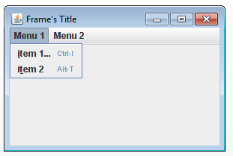
Menus(cont)
//menu
JMenu m1 = new JMenu("Menu 1");
m1.add(mi1);
m1.add(mi2);
JMenu m2 = new JMenu("Menu 2");
m2.add(mi3);
m2.add(mi4);
//menubar
JMenuBar mbar = new JMenuBar();
mbar.add(m1);
mbar.add(m2);
frame.setJMenuBar(mbar);
frame.setLocationRelativeTo(null);
frame.setVisible(true);

Slide 75
Dialogs
There are several ways to build dialog boxes:
JOptionPane - Simple Dialogs This is a very easy way (one statement) to build simple dialogs. Usually this, JFileChooser, and maybe JColorChooser are the only dialog classes that you need.
JFileChooser This will create and control a standard file chooser dialog.
javax.swing.JColorChooser You can call one static method (Color.showDialog(. . .)) to display a dialog that lets the user choose a color, or you can add listeners to make a more complicated dialog interaction, or you can use this class to create a color chooser pane.
javax.swing.Jdialog This can be used for building dialogs that are too complicated for JOptionPane.

Slide 76
Dialogs(cont)
Dialogs are attached to window (frame)
Every dialog is attached to a window (frame). When the window in iconified, the dialog will automatically disappear, and it will automatically reappear when the window is deiconified. When the window is destroyed, the dialog will disappear.
Dialogs are usually modal
When a dialog is active, input to other parts of the graphical user interface will be blocked. This kind of dialog is called a modal dialog. If you want a dialog which is modeless (allows interaction with other windows), you must use the JDialog class.

Slide 77
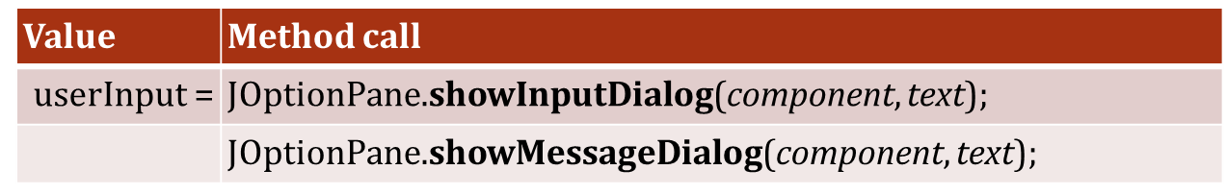
JOptionPane
Here are two useful static methods from javax.swing.JOptionPane that allow you to easily create dialog boxes for input and output. The Java API documentation has many more JOptionPane options, but these are sufficient for many uses. In the code below userInput and text are Strings.
Use null for the component parameter if you don't have a window
The dialog box will be centered over the component given in the first parameter. Typically you would give the window over which it should be centered. If your program doesn't have a window, you may simply write null, in which case the dialog box will be centered on the screen.

Slide 78
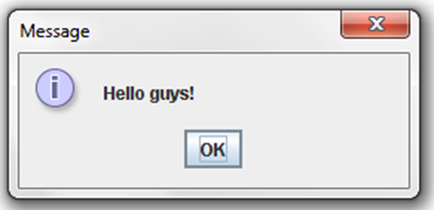
JOptionPane(cont)
JOptionPane.showMessageDialog(null, "Hello guys!");

Slide 79
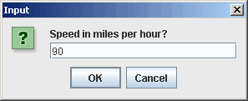
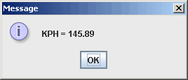
JOptionPane(eg 1)
This line displays a String, an input text field (JTextField), and OK and CANCEL buttons. If the user presses the OK button, the string in the text field is returned. If the user didn't type anything, the string "" is returned. If the user presses the CANCEL button, null is returned. Because this call returns a String, it's necessary in the next line to convert it into a double to do the arithmetic calculation.
This line displays a String and an OK button. In this call the String formed by concatenating a String literal with a number. When a String is concatenated with anything, that other operand is converted to a String by Java, then the two are put together into a new String.

Slide 80








JDialog (cont) Example
Icon description | Java look and feel | Windows look and feel
question
information
warning
error

Slide 81
JFileChooser
Use javax.swing.JFileChooser to create a file chooser for selecting a file or directory to open or save.
To display a file chooser
Use one of three methods to display the dialog after it has been created.
r = fc.showOpenDialog(owner); // button labeled "Open"
r = fc.showSaveDialog(owner); // button labeled "Save"
r = fc.showDialog(owner, title);
The owner parameter is the component (eg, JFrame, JPanel, ...) over which the dialog should be centered. You can use null for the owner, which will put the dialog in the center of the screen. The title parameter is a string that is used as the dialog's title and accept button text.

Slide 82
JFileChooser(cont)
Getting the selected file or directory
After checking for JFileChooser.APPROVE_OPTION, the File value of the selection is returned from a call on getSelectedFile.
int retval = fc.showOpenDialog(null);
if (retval == JFileChooser.APPROVE_OPTION) {
File myFile = fc.getSelectedFile();
// DO YOUR PROCESSING HERE. OPEN FILE OR
...
}

Slide 83
JTabbedPane
Description.
The JTabbedPane container allows many panels to occupy the same area of the interface, and the user may select which to show by clicking on a tab. A tab may also be selected by the program.
Constructor
JTabbedPane tp = new JTabbedPane(); // Defaults to tabs along the top edge. JTabbedPane tp = new JTabbedPane(edge);
Where edge specifies which edge the tabs are on
JTabbedPane.TOP (default)
JTabbedPane.RIGHT
JTabbedPane.BOTTOM
JTabbedPane.LEFT

Slide 84
JTabbedPane (cont)
JFrame f = new JFrame();
f.setTitle("Tab demo");
f.setSize(500,100);
JPanel p = new JPanel();
p.setLayout(new FlowLayout());
JPanel diagramPanel = new JPanel();
JPanel sqlPanel = new JPanel();
JPanel instructionPanel = new JPanel();
JTabbedPane display = new JTabbedPane();
display.addTab("Diagram View", diagramPanel);
display.addTab("SQL View" , sqlPanel);
display.addTab("Instructions", instructionPanel);
display.setSelectedIndex(1);
f.add(display);
f.setVisible(true);

Slide 85
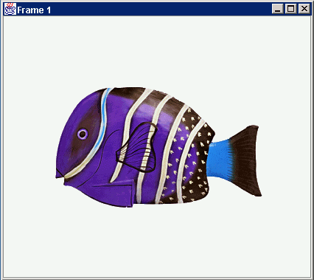
Anatomy of an Application GUI
GUI
Internal structure
JFrame
JFrame
JPanel
containers
JPanel
JButton
JButton
JLabel
JLabel

Slide 86
End of Part One
Next Part
Layout Manager

Slide 87
What Is Layout?
A layout is a set of rules that defines how graphical components should be positioned in a container.
Layouts tell Java where to put components in containers (JPanel, content pane, etc). Every panel (and other container) has a default layout, but it's better to set the layout explicitly for clarity.
Create a new layout object (using one of its constructors) and use the container's setLayout method to set the layout. Each layout has its own way to resize components to fit the layout, and you must become familiar with these.

Slide 88
Layout Managers
There are many types of layout managers:
FlowLayout
GridLayout
BorderLayout
CardLayout
GridBagLayout

Slide 89
FlowLayout
As you add components to your container, it adds them from left to right until it gets to the end of a line, and then it starts again on the next line.
left-to-right, row-by-row
If the container is resized, the components will adjust themselves to new positions.
Constructors:
public FlowLayout()
public FlowLayout(int align)
public FlowLayout(int align, int hgap, int vgap)

Slide 90
GridLayout
Is a layout manager that lays out a container’s components in a rectangular grid with the number of rows and columns that you specify.
The container is divided into equal-sized rectangles, and one component is placed in each rectangle.
Constructors:
public GridLayout()
public GridLayout(int rows, int cols)
public GridLayout(int rows, int cols, int hgap, int vgap)

Slide 91
Border Layout
Components are placed on the container in five distinct regions: north, south, east, west, center.
Constructor:
public BorderLayout()
public BorderLayout(int hgap, int vgap)
The containers add method can accept an optional constraint that specifies the location
add(button, BorderLayout.CENTER);

Slide 92
BorderLayout constraints
NORTH
CENTER
SOUTH
WEST
EAST

Slide 93
CardLayout
It treats each component in the container as an individual card.
It shows only one card at a time and the order that the components are added to the container is important; the first card added is the first card displayed when the application starts.
The layout manager maintains its own ordering of its components and provides a mechanism to either flip through the cards sequentially or show a specific card.

Slide 94
CardLayout constructor
public CardLayout()
public CardLayout(int hgap, int vgap)
To add components to a CardLayout, use the add(String, Component) method where the String specifies an identifier for the card and the component specifies the component to add.
When you are ready to show the card, you can call CardLayout class’s first, next, last, or show methods.

Slide 95
CardLayout Methods
first( Container parent)
next(Container parent)
last(Container parent)
show(Container parent, String name)
CardLayout la = new CardLayout();
la.next(this);
la.next(this);
la.last(this);
la.show(this, “btnone”);

Slide 96
GridBagLayout
Far more advanced than any of the other layout managers.
It is flexible layout manager that aligns components both vertically and horizontally, without requiring that the components be the same size.
It maintains a dynamic grid of cells where components can be placed and where the components can occupy one or more of the cells.

Slide 97
GridBagLayout constraints
Constructor:
public GridBagLayout()
Constraints:
gridx, gridy - specifies the grid x and y coordinates of the 0-based cell to place the component in. Use GridBagConstraints.RELATIVE (default value) to place the component in the container at the next cell following the- previous.
gridwidth, gridheight – specifies the number of cells the component should occupy in the grid.
fill – when the component’s display area (area it is given to show itself) is larger than the control, this variable specifies how it should fill the remaining area. Values: NONE (default) = do not adjust the size of the components, HORIZONTAL = fill up the width of the area only, VERTICAL = fill up the height of the area only, and GridBagConstraints.BOTH = fill up the entire display area.

Slide 98
Cont’d
ipadx, ipady - specifies the component’s internal padding, or the area outside of the component to count as part of the size of the component.
insets - specifies the component’s external padding, or the minimum amount of space between the component and its display area.
anchor – when the component is smaller than its display area, this variable specifies how it should be drawn in the area: CENTER, NORTH, NORTHEAST, EAST, SOUTHEAST, SOUTH, SOUTHWEST, WEST, NORTHWEST.
weightx, weighty – specifies how to distribute space between components, important when your application is resized. These values specify the widths and heights relative to the other components in the frame. Note that you must specify a weight for at least one component in a row and a column or all components will clump together in the center of the container.

Slide 99
Example:
GridBagLayout la = new GridBagLayout();
GridBagConstraints con=new GridBagConstraints();
setLayout(la);
con.fill = GridBagConsraints.BOTH;
add(btnone);
add(btnntwo);
con.weightx = 1.0;
la.setConstraints(btnone, con);
la.setConstraints(btntwo, con);
add(btnthree);
con.gridwidth=GridBagConstraints.REMAINDER;
la,.setConnstraints(btnthree, con);
add(btnfour);
con.gridwidth = 2;
con.gridheight = 2;
con.weighty = 1.0;
la.setConstraints(btnfour, con);

Slide 100
Cont’d
add(btnfive);
con.gridwidth = gridbagconstraints.remainder;
la.setconstraints(btnfive, con);
con.weighty = 0;
add(btnsix);
con.gridwidth = gridbagconstraints.remainser;
la.setconstraints(btnsix, con);
add(btnseven); add(btneight); add(btnnine);
con.gridwidth = 1;
con.weighty = 2.0;
la.setconstraints(btnseven, con);
la.setconstraints(btneight, con);
la.setconstraints(btnnine, con);
add(btnten);
con.gridwidth = gridbagconstraints.remainder;
la.setconstraints(btnten, con);

Slide 101
End of Part two
Next Part
Event

Slide 102
At the end of this chapter students will be able to
Define events and event handling
Write code to handle events that occur in a GUI
Determine the user action that originated the event from the event object details
Identify the appropriate interface for a variety of event types
Create the appropriate event handler methods for a variety of event types
Create inner classes and anonymous classes in event handling

Slide 103
Events -- Introduction
In life, you encounter events that force you to suspend other activities and respond to them immediately. .
In Java, events represent all activities that go on between the user and the application/program.
Changing the state of an object is known as an event.
Events come from User Controls
When you define a user interface, you will usually have some way to get user input. For example, buttons, menus, sliders, mouse clicks, ... all generate events when the user does something with them.
Events can be
Keystrokes
mouse clicks, or Mouse moving over the component etc

Slide 104
Events Handling
In the event handling process, there are three important players
Event Source
Event Listener/Handler
Event Object

Slide 105
Event Sources
A source is an object that generates an event.
occurs when the internal state of that object changes in some way.
A source must register listeners in order for the listeners to receive notifications about a specific type of event.
Each type of event has its own registration method. Here is the general form:
public void addTypeListener(TypeListener el)
Here, Type is the name of the event, and el is a reference to the event listener. For example, the method that registers a keyboard event listener is called addKeyListener( ). The method that registers a mouse motion listener is called addMouseMotionListener( ). When an event occurs, all registered listeners are notified and receive a copy of the event object.

Slide 106
Event Object
Created when an event occurs (i.e., user interacts with a GUI component)
Contains all necessary information about the event that has occurred
Type of event that has occurred
Source of the event
Represented by an Event class

Slide 107
Listeners
A listener is an object that is notified when an event occurs
It has two major requirements
First, it must have been registered with one or more sources to receive notifications about specific types of events
Second, it must implement methods to receive and process these notifications
The methods that receive and process events are defined in a set of interfaces found in java.awt. event. For example, the mouseMotionListener interface defines two methods to receive notifications when the mouse is dragged or moved.

Slide 108
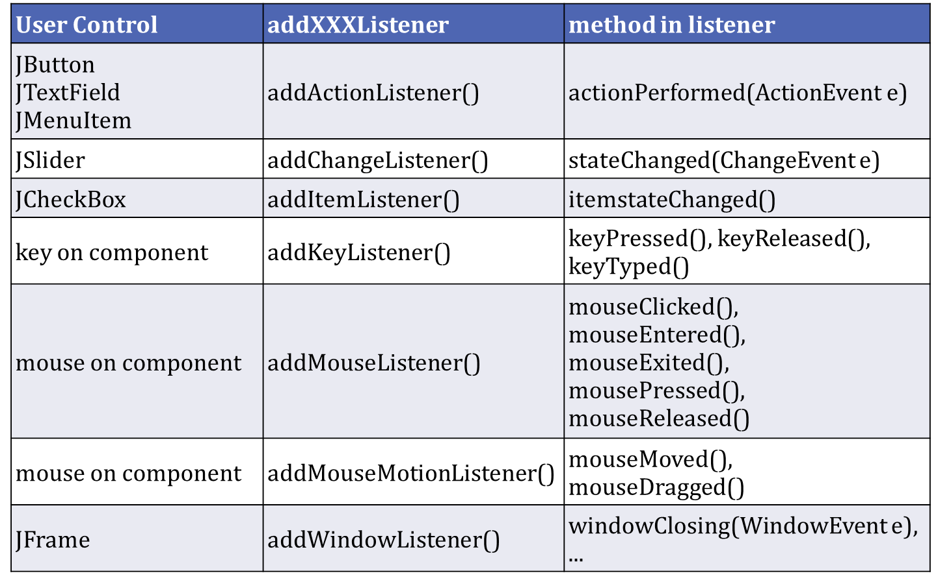
Types of Events
There are several kinds of events. The most common are:

Slide 109
Listeners(cont)
Common Listener Strategies
- Here are common ways to write listeners:
Named Inner Class Listeners are one of the most common ways to write small programs. They are convenient to write and be shared with several components.
Anonymous Inner Class Listeners are sometimes used to associate a different listener with each button or other control. This is a little quicker to write, but lacks some of the flexibility of inner class listeners.
Top-level Listeners (this) are commonly used where there is only one source of an event. For example, if you are defining a subclass of JPanel to use for drawing with a mouse, an instance of this new class will typically also be the mouse event listener. Similarly with a JPanel used for animation -- the panel itself may serve as the ActionListener for the Timer. Do not use "this" as a listener for buttons, menus, etc. because all controls must then share that one action listener.

Slide 110
Inner-class Listeners(cont)
Defining an inner class listener to handle events is a very popular style.
Access. Use an inner class rather than an outer class to access instance variables of the enclosing class. In the example below, the myGreetingField can be referenced by the listener class. Because simple program listeners typically get or set values of other widgets in the interface, it is very convenient to use an inner class.
Reuse. Unlike anonymous inner class listeners, it's easy to reuse the same listener for more than one control, eg, the click of a button might perform the same action as the equivalent menu item, and might be the same as hitting the enter key in a text field.
Organization. It's easier to group all the listeners together with inner classes than with anonymous inner class listeners.

Slide 111
Inner-class Listeners(cont)
Examples: Partial source code to share one inner class listener
import javax.swing.*;
import java.awt.event.*;
class SomePanel extends JPanel {
private JButton myGreetingButton = new JButton("Hello");
private JTextField myGreetingField = new JTextField(20);
public SomePanel() { //=== Constructor
ActionListener doGreeting = new GreetingListener();
myGreetingButton.addActionListener(doGreeting); myGreetingField.addActionListener(doGreeting);
// . . . Layout the panel.
}
/////////////////////////// Define inner class as listener.
private class GreetingListener implements ActionListener {
public void actionPerformed(ActionEvent e) {
myGreetingField.setText("Guten Tag");
}
}
}

Slide 112
Inner-class Listeners(cont)
JTextField inField = new JTextField(10);
. . .
// Create an action listener that adds the key name to a field
ActionListener keyIn = new ActionListener() {
public void actionPerformed(ActionEvent e) {
// Get the name of the button
String keyNum = e.getActionCommand(); // "1", "2", ... inField.setText(inField.getText() + keyNum);
}
};
// Create many buttons with the same listener
JButton key1 = new JButton("1");
key1.addActionListener(keyIn);
JButton key2 = new JButton("2");
key2.addActionListener(keyIn);
JButton key3 = new JButton("3");
key3.addActionListener(keyIn);
. . .

Slide 113

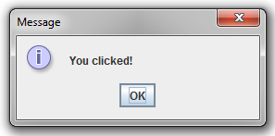
Inner-class Listeners(cont)
public class InnerDemo extends JFrame {
JButton but = new JButton("click here");
//constructor
public InnerDemo(){
setDefaultCloseOperation(JFrame.EXIT_ON_CLOSE);
ActionListener actLis = new NewActLis();
but.addActionListener(actLis);
add(but);
pack();
setVisible(true);
}
public static void main(String[] a){
InnerDemo inner = new InnerDemo();
}
public class NewActLis implements ActionListener{
public void actionPerformed(ActionEvent a){
JOptionPane.showMessageDialog(null, "You clicked!");
}
}
}
When clicked :-

Slide 114
Anonymous Listeners
A common idiom
There is no need to define a named class simply to add a listener object to a button. Java has a somewhat obscure syntax for creating an anonymous innner class listener that implements an interface. For example,
class myPanel extends JPanel {
. . .
public MyPanel() {
. . .
//in the constructor JButton b1 = new JButton("Hello"); b1.addActionListener( new ActionListener() {
public void actionPerformed(ActionEvent e) {
// do something for button b1
}
} );
……
……

Slide 115
Anonymous Listeners
Eg:
public class AnnoDemo {
public static void main(String[] a){
JButton but = new JButton("Press Me");
but.addActionListener(new ActionListener() {
public void actionPerformed(ActionEvent ev) {
JOptionPane.showMessageDialog(null, "You pressed me");
System.out.println(“Button's clicked dude!");
}});
JFrame f = new JFrame();
f.setDefaultCloseOperation(JFrame.EXIT_ON_CLOSE);
f.getContentPane().add(but);
f.pack();
f.setVisible(true);
}
}
When clicked :-
Console Output
Button’s clicked

Slide 116
Top-level Listeners
Using this as a listener
A common way to write simple applets is to use the applet itself as a listener (referred to as this). For example
This doesn't seem to be a problem for small programs, but what happens if there is more than one button? There can be only one actionPerformed() method in a class.

Slide 117

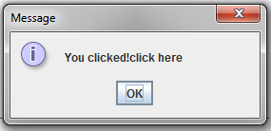
Top-level Listeners(cont)
public class TopLevelDemo extends JFrame implements ActionListener {
JButton but = new JButton("click here");
//constructor
public TopLevelDemo (){
setDefaultCloseOperation(JFrame.EXIT_ON_CLOSE);
but.addActionListener(this); //
add(but);
pack();
setVisible(true);
}
public void actionPerformed(ActionEvent a){
JOptionPane.showMessageDialog(null, "You clicked!");
}
public static void main(String[] a){
TopLevelDemo n = new TopLevelDemo ();
}
}
When clicked :-

Slide 118
Top-level Listeners(cont)
Problem: One listener for many components
Inside the listener method, it's possible to check the parameter to find out which component caused the event. For example,
JButton b1, b2;
. . .
public MyClass() {
// constructor
...
b1.addActionListener(this);
...
b2.addActionListener(this);
// SAME listener!
...
}//end constructor
public void actionPerformed(ActionEvent e) {
Object obj = e.getSource(); // get the control that
//caused the event
if (obj instanceof JButton) {// make sure it's a button.
JButton b = (JButton)obj;
// downcast to a button
if (b == b1) { // UGLY, DON'T DO THIS // do something for button b1
}
else if (b == b2) {
// do something for button b2
}
}
else if (o instanceof JTextField) {
...
...

Slide 119
Top-level Listeners(cont)
public class NewClass extends JFrame implements ActionListener {
JButton but1 = new JButton("click here 1");
JButton but2 = new JButton("click here 2");
//constructor
public NewClass(){
setDefaultCloseOperation(JFrame.EXIT_ON_CLOSE);
JPanel p = new JPanel();
but1.addActionListener(this);
p.add(but1);
but2.addActionListener(this);
p.add(but2);
add(p);
pack();
setVisible(true);
}
Cont…

Slide 120

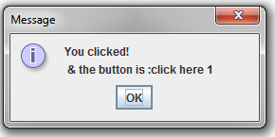
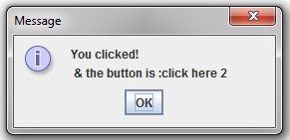
Top-level Listeners(cont)
public void actionPerformed(ActionEvent a){
String whichButton = a.getActionCommand();
JOptionPane.showMessageDialog(null, "You clicked! & the button is :" + whichButton);
}
public static void main(String[] a){
NewClass n = new NewClass();
}
}//end of class

Slide 121
(End) Chapter 1

